Slide 1
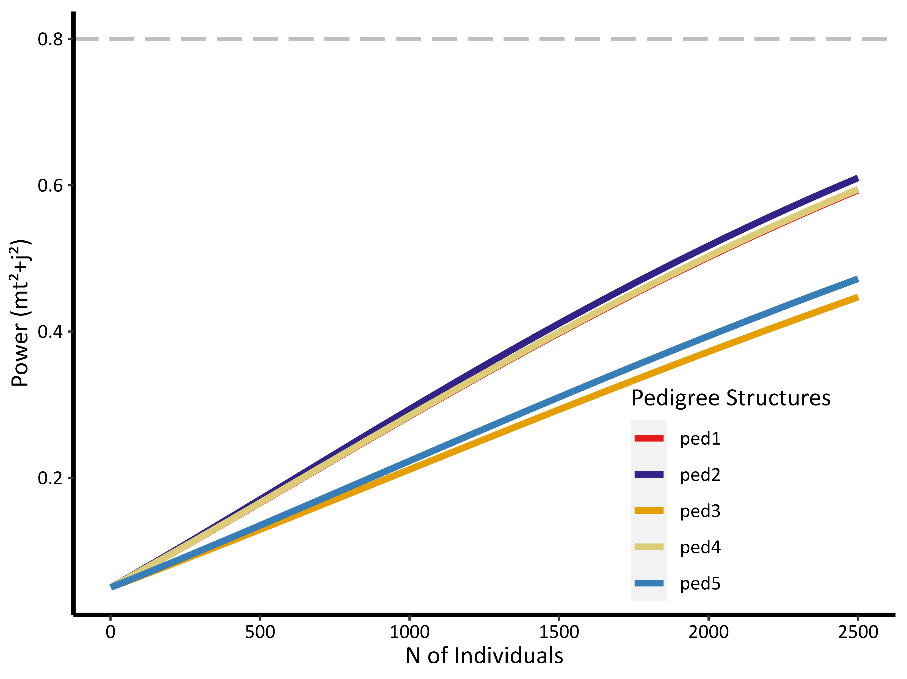

Slide 2
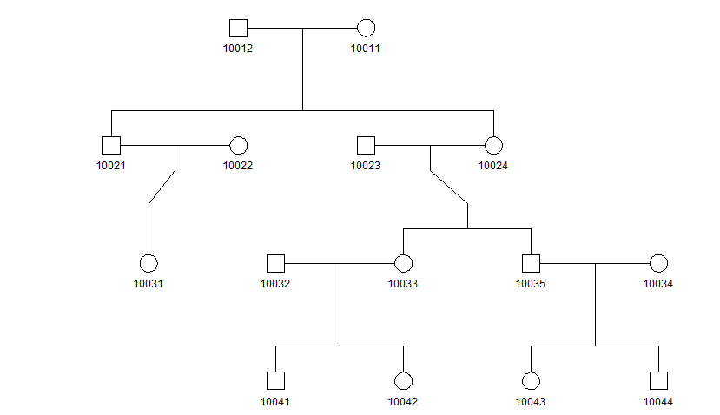
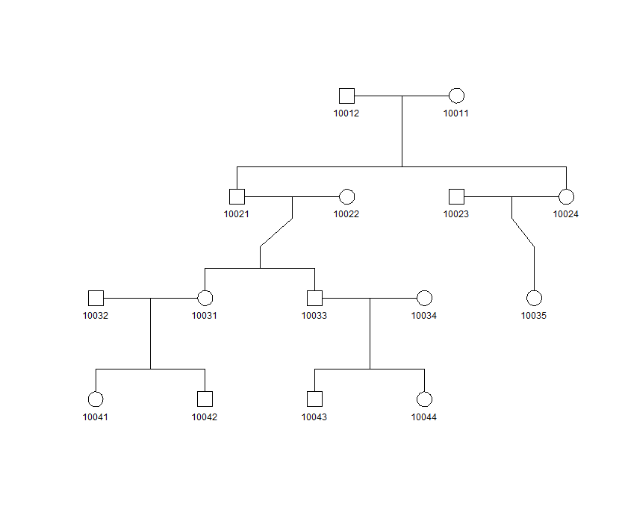
ped3
ped2
 | a2 | mt2 | n
1 | 0 | 0 | 80
2 | 0.0625 | 0 | 8
3 | 0.125 | 0 | 28
4 | 0.125 | 1 | 8
5 | 0.25 | 0 | 26
6 | 0.25 | 1 | 16
7 | 0.5 | 0 | 18
8 | 0.5 | 1 | 26
9 | 1 | 1 | 15
 | a2 | mt2 | n
1 | 0 | 0 | 80
2 | 0.0625 | 0 | 8
3 | 0.125 | 0 | 36
4 | 0.25 | 0 | 30
5 | 0.25 | 1 | 12
6 | 0.5 | 0 | 18
7 | 0.5 | 1 | 26
8 | 1 | 1 | 15

